Slide 1
40470587 Joshua Sheridan Web Reference PPT

Slide 2
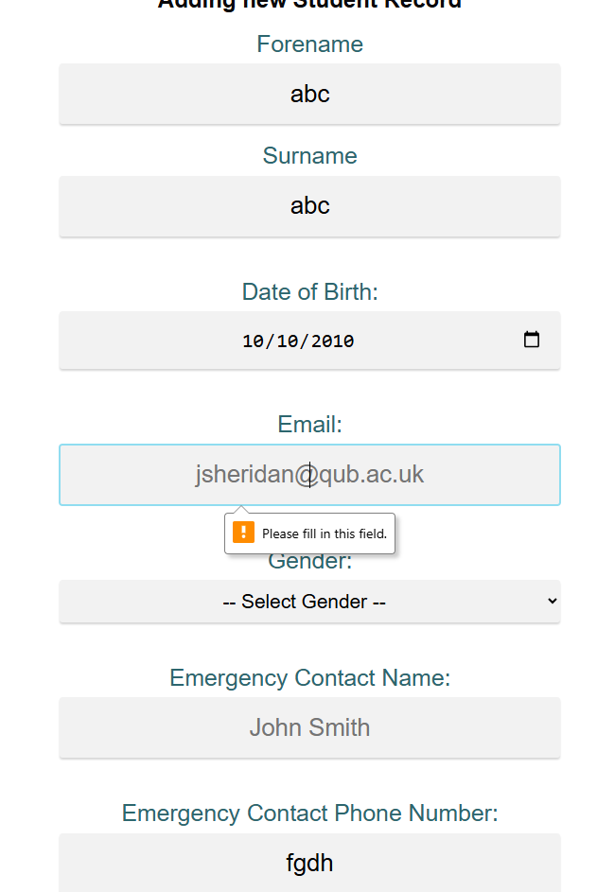
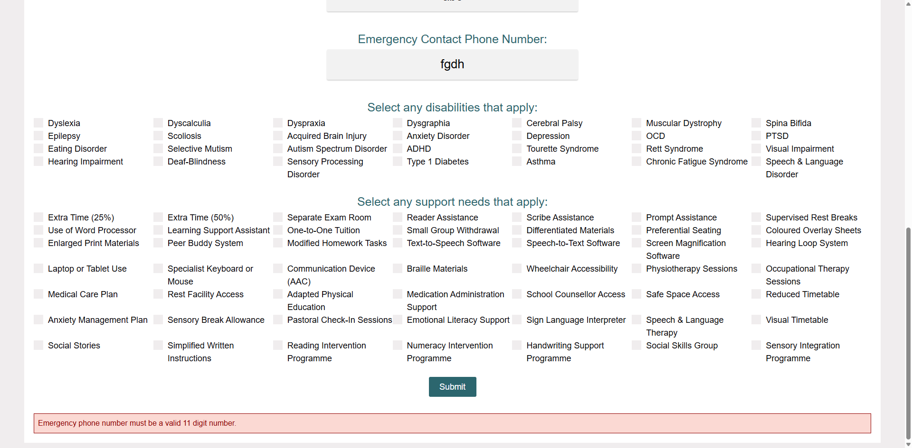
Client Side Validation
In the student record form, client side validation has been implemented across all fields.
This ranges from using the HTML required tag to dynamically validating the fields using JavaScript to ensure that the data entered is in the correct format.
In the screenshots, data has been entered with some fields missing or in an incorrect format. One Screenshot shows the HTML required tag working as intended, and the other screenshot shows the JavaScript validation preventing the user from entering a string as the phone number

Slide 3
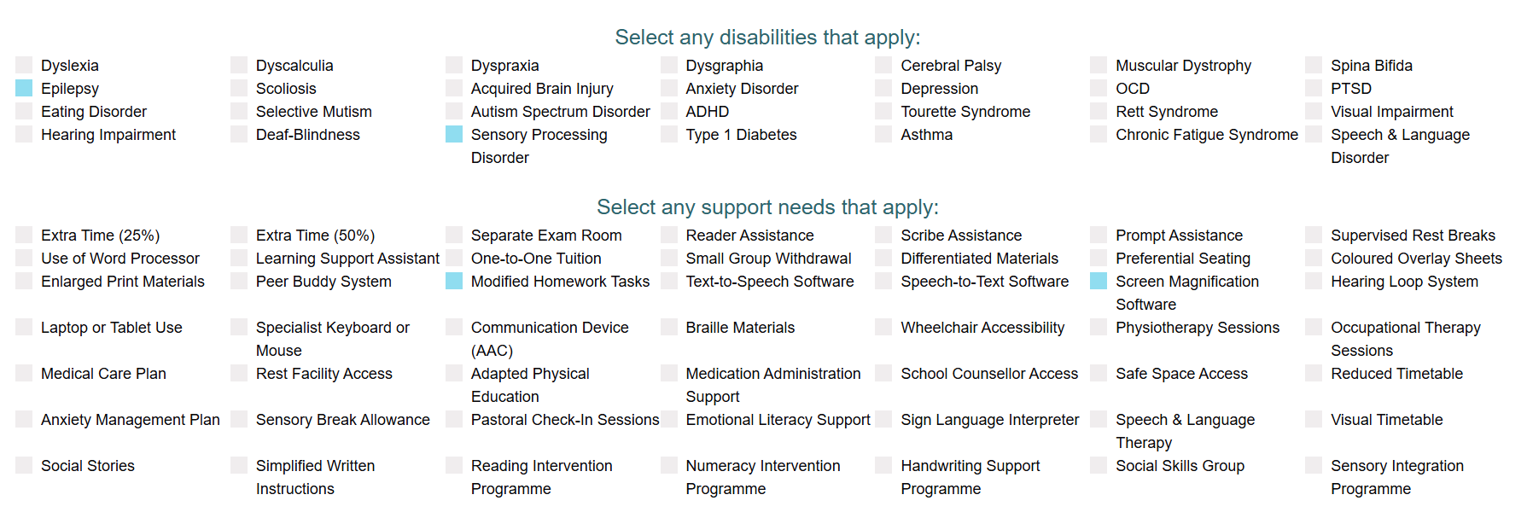
Dynamic Checkbox Generation
Each of these checkboxes are dynamically created in the JavaScript.
After the page has loaded, the webpage will retrieve all of the Disabilities and Assistances from the database, then create a checkbox for each of them using the ID in the table as the value.

Slide 4
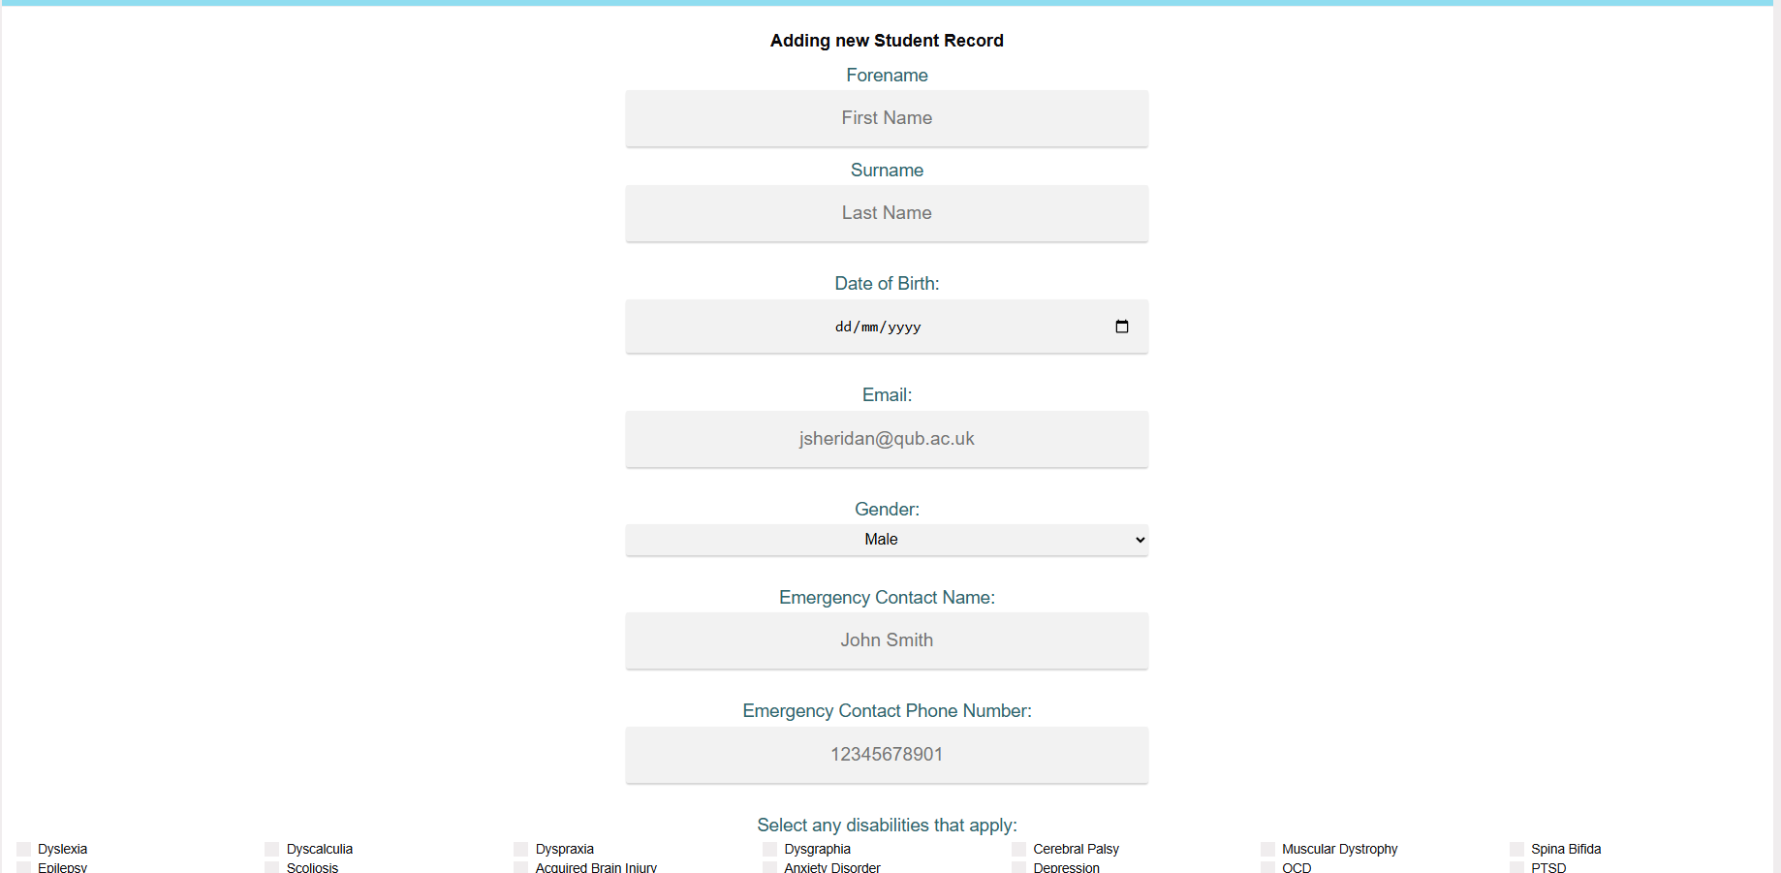
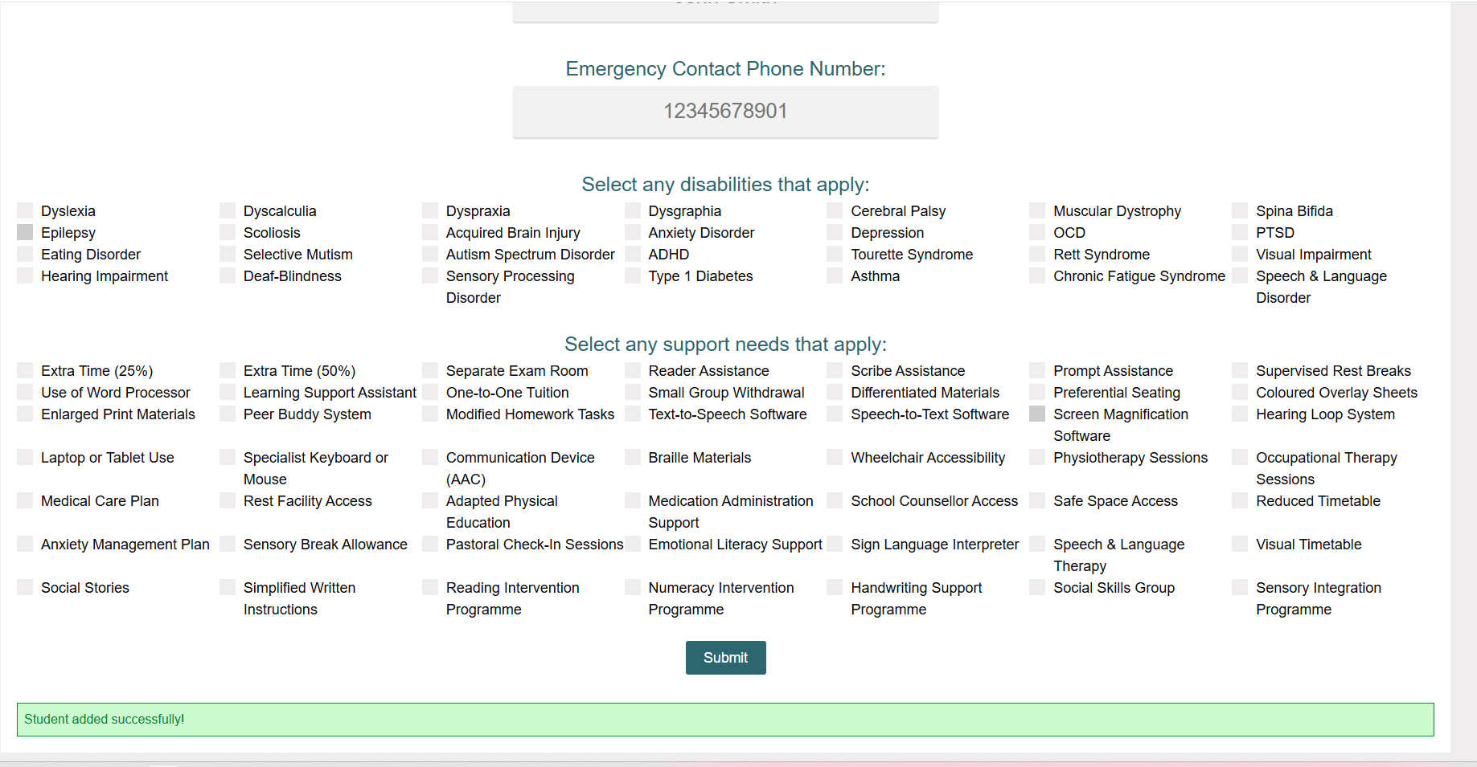
Add Record (Create)
Each field in the add student form represents a field within the database.
After the user submits the form, the data is validated then added into the database.
If the data is successfully added, the message in the screenshot is shown to the user.
If there is some sort of error adding the data to the database, the corresponding error message will be shown to the user.

Slide 5
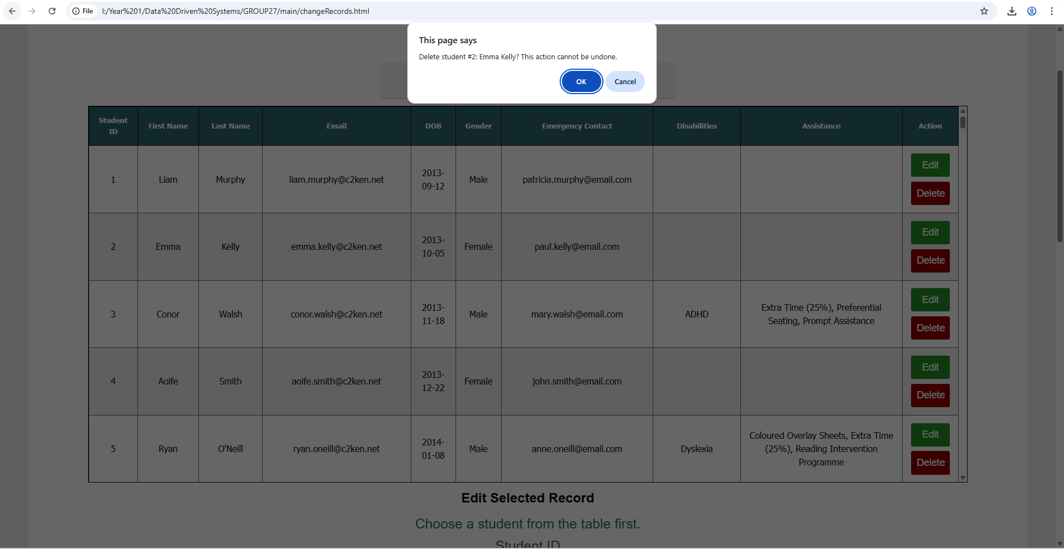
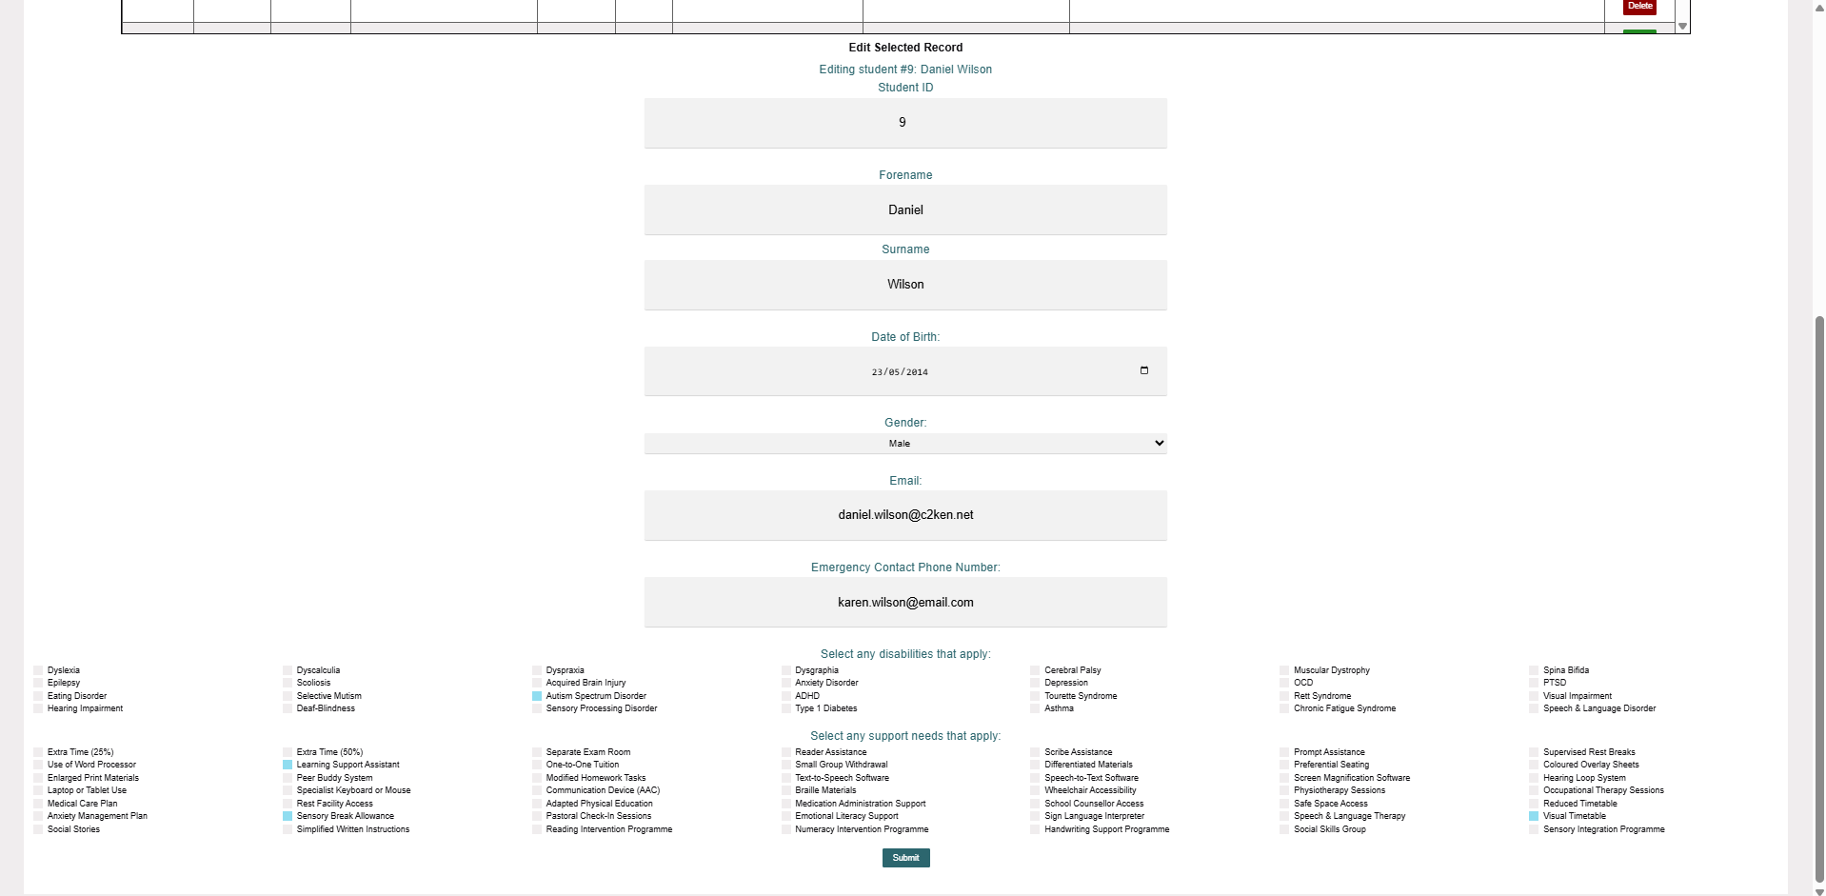
Edit/Delete Student Records
One of the screenshots shows the confirmation given to the user before they delete a student record.
The other screenshot shows the form below the table after the edit button has been clicked.
All of the student’s information is copied into the form on click of the edit button.
After clicking submit on the form the same validation for the add student form takes place.
The data is then updated in the database.

Slide 6
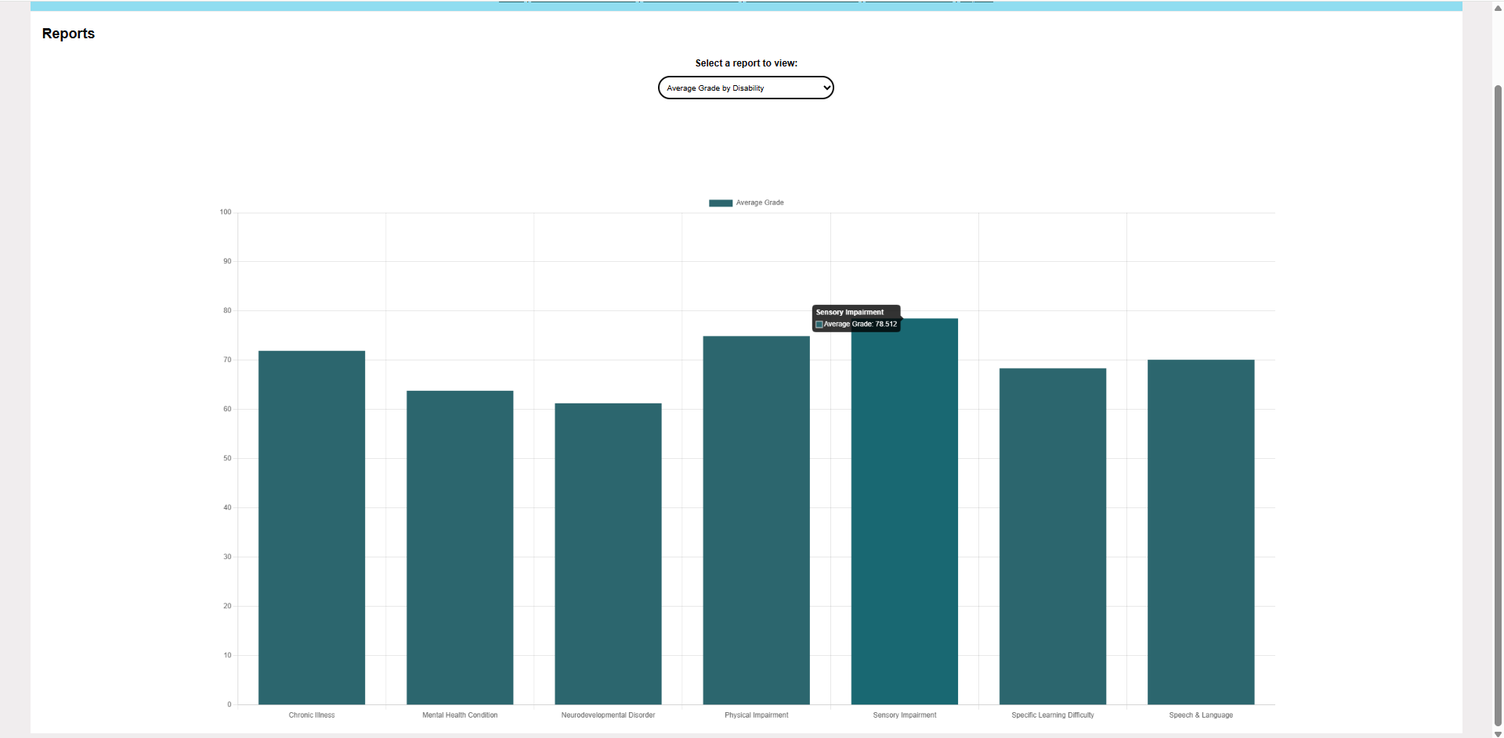
Parameterised Reports
This is one of my 3 reports. This Specific report show the average grade for each disability type across all tests.
The data is pulled live from the database then the format is changed and shown in a bar chart.
The number of bars also changes dynamically, so if the school were to enrol another student with a different type of disability they would also be included in the chart.

